Slide 1
Blockchain Based Non-repudiable IoT Data Trading: Simpler, Faster, and Cheaper
INFOCOM 2022
王子平

Slide 2






Background
What is IoT data trading ? and Why？
28.5 billion IoT devices util 2021
875 ZB IoT data was created in 2021
3.9 trillion USD market value of data economy util 2030
Send the data
extract
Data buyer
Data owner
Send the money
Value
Privacy

Slide 3


The traditional data trading pattern
Deny the effectiveness of the data
(2)Send the data
(1)Data request，
Pay the fee
(3)Receive the fee
Data buyer
Data market
Data owner
Cheat together
The traditional data trading pattern
Imperfect legal system

Slide 4

Two Traditional non-repudiation mechanism
Trusted third party based(TTP-based) approaches（1996-1997）
Key idea: TTP records the interactive evidence.e.g. digital signature
Probabilistic approaches（1999-2001）
Key idea: Data owner encrypt the data and send the decryption key in multiple interaction.
evidence
Data buyer
TTP
Data owner
evidence
Send the encrypted data
Data buyer
......
Data owner
Get the decryption key

Slide 5
Two Traditional non-repudiation mechanism
Trusted third party based(TTP-based) approaches（1996-1997）
Problem：single point of failure; an inherent trust issue
Probabilistic approaches（1999-2001）
Problem：The scheme requires multiple communication rounds; inefficient for loT applications
Evidence
Data buyer
TTP
Data owner
Evidence
Trusted?
Send the encrypted data
......
Data buyer
Data owner
Heavy computation
Get the decryption key

Slide 6
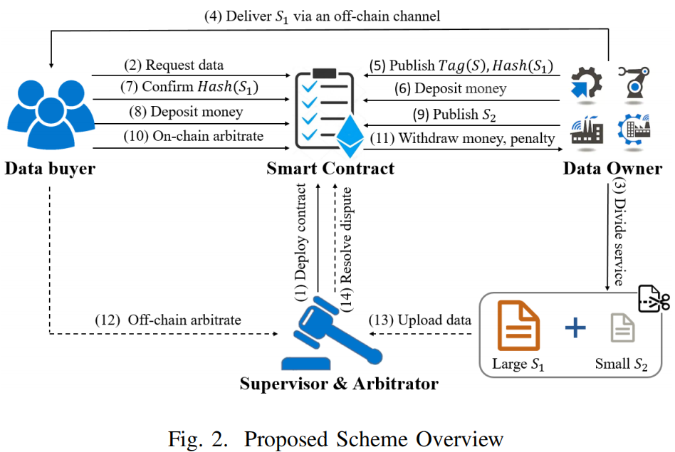

Blockchain based non-repudiation scheme
Advantages: Temper-resistant； Consensus machanism
All events
S
two-stage
Data buyer
Blockchain
Data owner
All events
Evidence
Homomorphic hashing
Refuse to write
on-chain arbitrate
Problem:
Inadequate fairness
Inefficient
Buyer’s risk

Slide 7
The proposed scheme

Slide 8
Technical point 1: enensure the non-repudiation requirement
Based on on-chain arbitrate , add the off-chain arbitrate
Equality
Data owner
Data buyer
Protect
Protect
On-chain arbitrate
Off-chain arbitrate

Slide 9
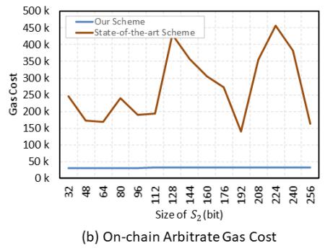
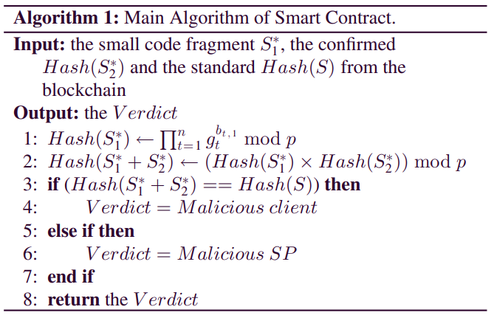
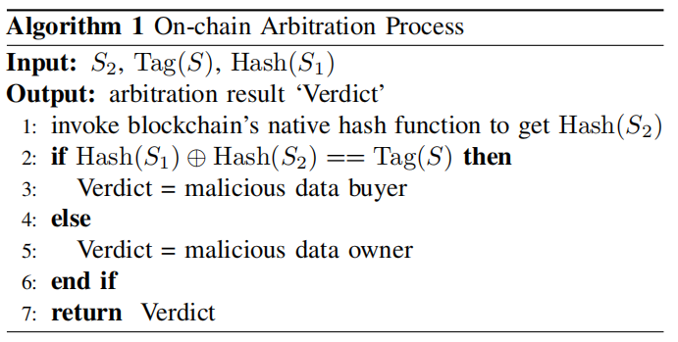
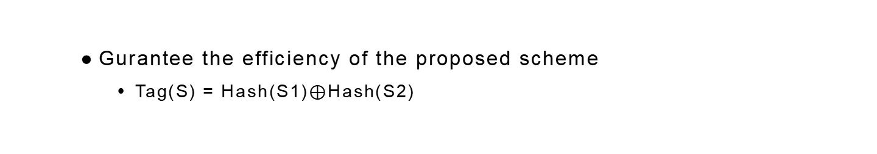
Technical point 2: guarantee the efficiency of the proposed scheme
Gurantee the efficiency of the proposed scheme
Tag(S) = Hash(S1)$⊕$Hash(S2)
93%
78%

Slide 10
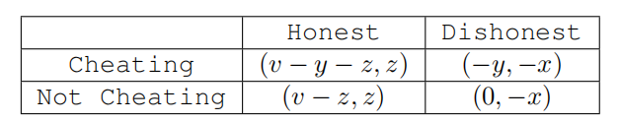
Technical point 3:minimize the possible disputes
Incetive mechanism(penalty) to motivate both the partied to act honestly
Data buyer
Data owner
x, y denotes penalty
v denotes the value of the data
z denotes the price of the data

Slide 11
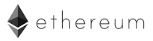



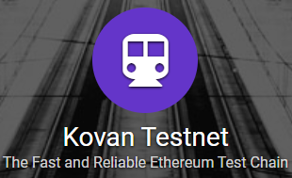

Experimental Implementation
Arbitrator
Request data
Publish sender proof
Publish receiver proof
Data buyer
Make data available
On-chain arbitrate
Key indicator for end user
Wallet
Off-chain arbitrate
Smart
contract
Data owner
Gas cost

Slide 12
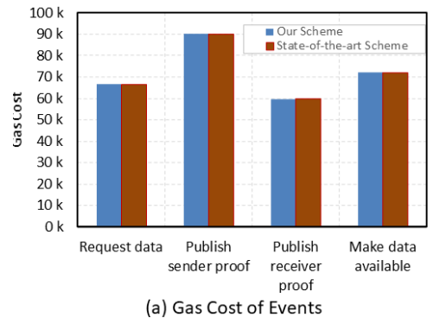
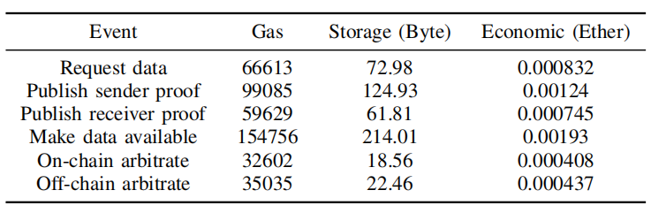
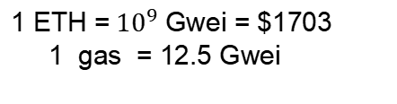
Experimental Result
$1.42
$2.11
$1.29
$3.29
$0.69
$0.74
93%
78%
1 ETH =${ 10}^{9}$ Gwei = $1703
1 gas = 12.5 Gwei

Slide 13
Shortcoming
Off-chain arbitration
Data onwer’s data security and privacy
Arbitrator’s ability
& buyer’s benefit
Equality?
Upload data
Data owner
Data buyer
Arbitrator
Data owner

